Slide 1

Java 8 Features

Slide 2
Features
01
02
03
Default Method
Functional Interface
Lamda Expression
04
05
06
Method Reference
Stream API
Optional Class
07
Date and Time API

Slide 3
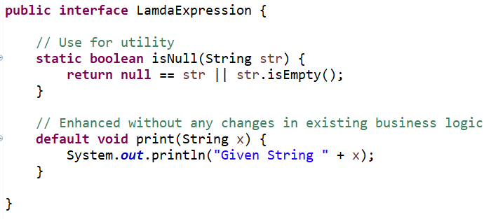
Default and Static Methods
Default Method:
Backward Compatibility
Without breaking existing code
Allow inherit without override
Static Method:
Useful for utilities
Can’t override

Slide 4
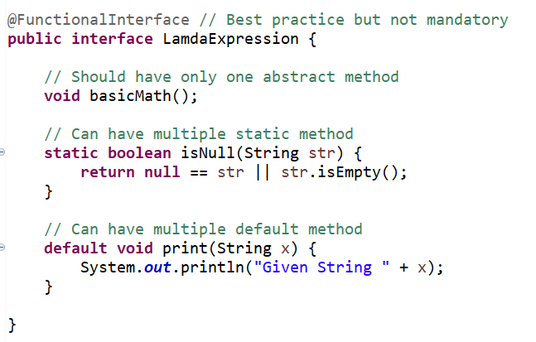
Functional Interface
Previously need to create anonymous inner classes
Need to write more code
Hard to maintain
introduced predicate, consumer, supplier

Slide 5
Lambda Expression
Works only in functional interface
Method data type and return type should be same.
Parameter should be same.

Slide 6
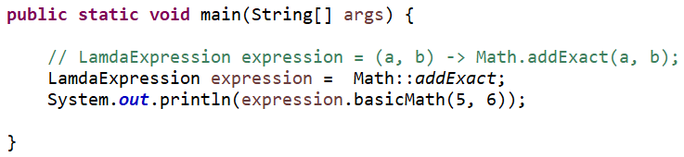
Method Reference
Shortest form of lambda expression
Refer a method without executing them
Four types
static method reference
Method of a particular object
Method of an Arbitrary object like wrapper classes
Reference of constructor

Slide 7
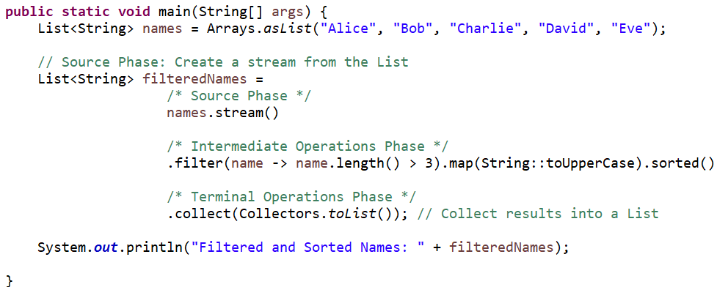
Stream API
Stream structure (source, intermediate operations, terminal operations)
Laziness, pipelining, Declarative style and flexibility
phase of stream is split, apply and combine

Slide 8
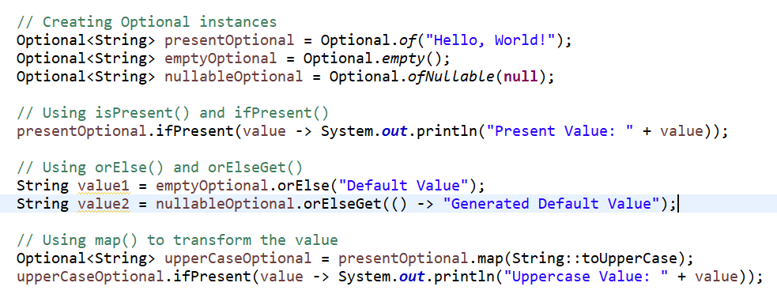
Optional Class
Help to handle the null pointer exception
Provides in a functional programing style like continue with operations

Slide 9
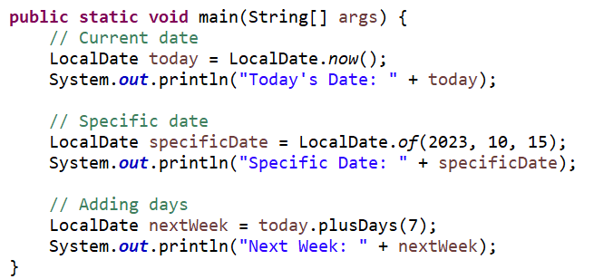
Date and Time API
It addresses the shortcomings of the older java.util.Date and java.util.Calendar classes
The new API is designed to be immutable, thread-safe, and more intuitive.
it easier to work with dates and times.

